Slide 1
Project Summary (Week 1-3)
A summary of the projects completed over three weeks.

Slide 2
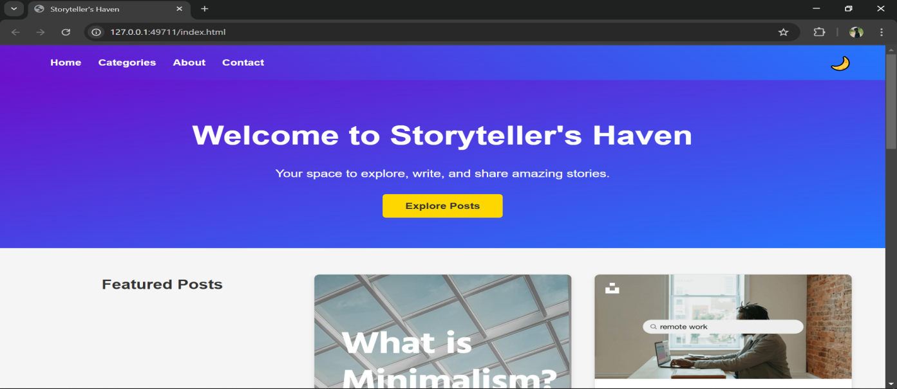
Week-1 : Storytellers Haven
Overview: A blog template for aspiring writers.
Key Features :
Homepage with blog previews
Navebar with categories
Footer with social media links
Responsive design
Light/Dark mode toggle
Tools & Technologies Used
HTML
CSS
JavaScript

Slide 3
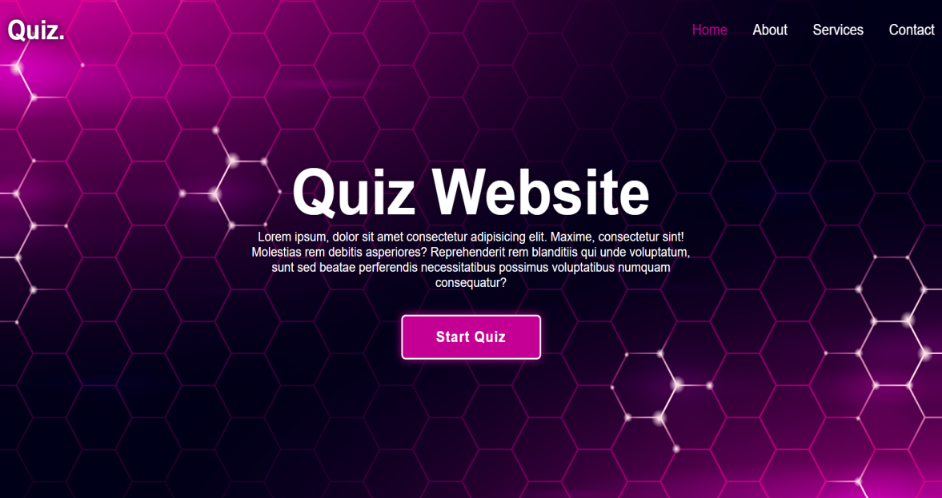
Week-2 : The quiz wizard
Overview: An interactive quiz game for learning and entertainment..
Key Features :
Score display at the end of the quiz.
Themed Visual and easy to use.
Progress bar for quiz completion
In pie chart to show score.
Tools & Technologies Used
HTML
CSS
JavaScript

Slide 4
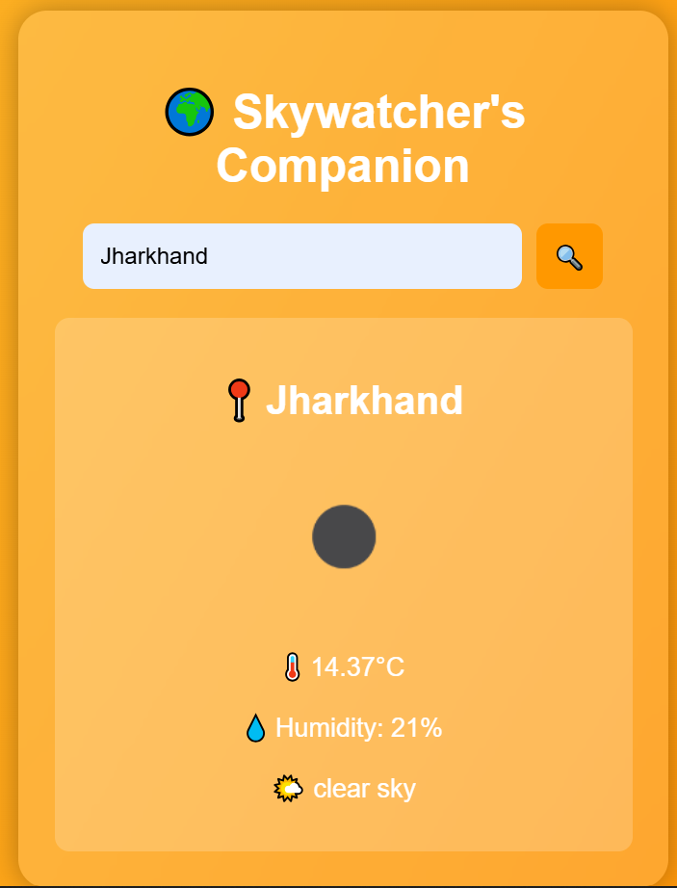
Week-3 : Skywatchers Companion
Overview: A weather deshboard providing real-time weather updates.
Key Features :
Fatch and display weather details (temperature, humidity, conditions) using an API.
Search bar for users to check weather by city.
Visually appealing design using CSS.
Dynamic background based on weather conditions (e.g: Sunny, Rainy)
In pie chart to show score.
Tools & Technologies Used
HTML
CSS
JavaScript
OpenWeatherMap API

